Slide 1
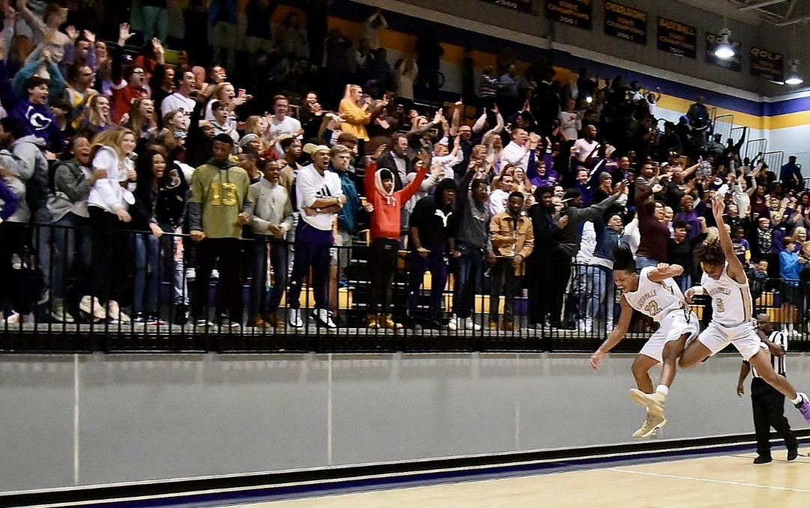
CARTERSVILLE HIGH SCHOOL BOYS BASKETBALL
2012-2023
Past 11 seasons

Slide 2
Cartersville High School
Boys Basketball
191 Wins
17 wins per season
9 GHSA State Tournament Appearances
Elite 8 (2014 & 2018 & 2019)
Sweet Sixteen (2013 & 2015)
6 Region Championships
Region 5AAAA Regular Season (2018)
Region 7AAAA Champions (2015, 2016)
Region 5AAA Regular Season (2014)
Region 5AAA Champions (2013, 2014)
6 Holiday Tournament Championships
Dalton Holiday Classic (2016)
North Paulding Classic Tournament Champions (2015)
Rome News Tribune Holiday Festival (2013 & 2014 & 2018)
Tiger Christmas Clash Champions (2020)

Slide 3
NW Georgia Tip-Off Club Team of the Year
2012-2013 & 2013-2014
#1 Ranked 5AAA Offense (79ppg, 2013-14 and 71ppg 2012-13)
#1 Ranked 5AAA Defense (47 papg 2013-14 and 44 papg 2012-13)
Undefeated at Home (2013-2014) (2017-2018)
Undefeated on the Road (2012-2013)
18 game winning streak (2013-2014)
24 Game winning streak (2012-2013)
Most Season wins in School History (27: 2012-2013 & 2013-2014)

Slide 4
Academic Excellence Team 90%+ Cumulative Grade Point Average
2012-2013
Hunter Benham Ryan Davis Christian Demastus Caleb Gridley Corey Tobin Zack Hacker
2013-2014
Hunter Benham Cortney Cooley Ryan Davis Christian Demastus Caleb Gridley Gabriel Gridley
Zack Hacker Mark Quattlebaum Corey Tobin 2014-2015
Cortney Cooley Miller Forristall Caleb Gridley Zack Hacker Carson Murray Jaylon Pugh
2015-2016
Cade Archer Daunta Bryan Tristan Carlton Ethan Carter Kaleb Chatmon Xavior Coaxum
Cortney Cooley Perignon Dyer Gabriel Gridley Isaac Gridley Bobby Harris Grant Harris
JKobe Orr Darian Poellnitz Jaylon Pugh 2016-2017
Daunta Bryan Kaleb Chatman Perignon Dyer Isaac Gridley Jacorey Johns Jaylon Pugh
JKobe Orr Jordan Wilkie 2017-2018
Austin Cauffman Marquail Coaxum Marko Dudley Perignon Dyer Jaylen Garnigan Isaac Gridley
Grant Harris Jayden Pritchett Jaylon Pugh 2018-2019
Michael Abernathy Kolbe Benham Austin Cauffman Marquail Coaxum Perignon Dyer Jaylin Garnigan
Isaac Gridley Emmanuel Hayes Quante Jennings Robert Novak Chandler Wise
2019-2020
Jaylen Benham Kolbe Benham Kamryn Callahan Marquail Coaxum Kedrick Chatmon
Marko Dudley Luke Gambill Manny Hayes Kyler Johnson Luke Kotteman
Robert Novak Jaeden Scott Brynen Wilkins 2020-2021
Kace Adams Jaylen Benham Kolbe Benham Kam Callahan Collin Fletcher Luke Gambill
Luke Kottemann Robert Novak Romo Pace Jaylin Scott Sam Wiedetz
2021-2022
Kam Callahan Kedrick Chatmon Luke Gambill Collin Genrich Chandler Mathison Romo Pace
Sahaj Patel Kaden Scott Jaylen Scott Monte Tolbert Michael Watts
2020-2021
Catden Aleman Zion Ayeni Nasier Bennett Jamauri Brice Reed Ezell Ryder Flemmons
Collin Fletcher Collin Genrich Kole Hardin Cam Hill William Irish Sam James
Jake Johnson James Lee Martin Maldanado Chandler Mathison Andrew McElvey Romo Pace
Xavier Parker Jaylen Scott Shakai Taylor Zac Tolbert Monte Tolbert Logan VanPelt Sam Wiedetz

Slide 5
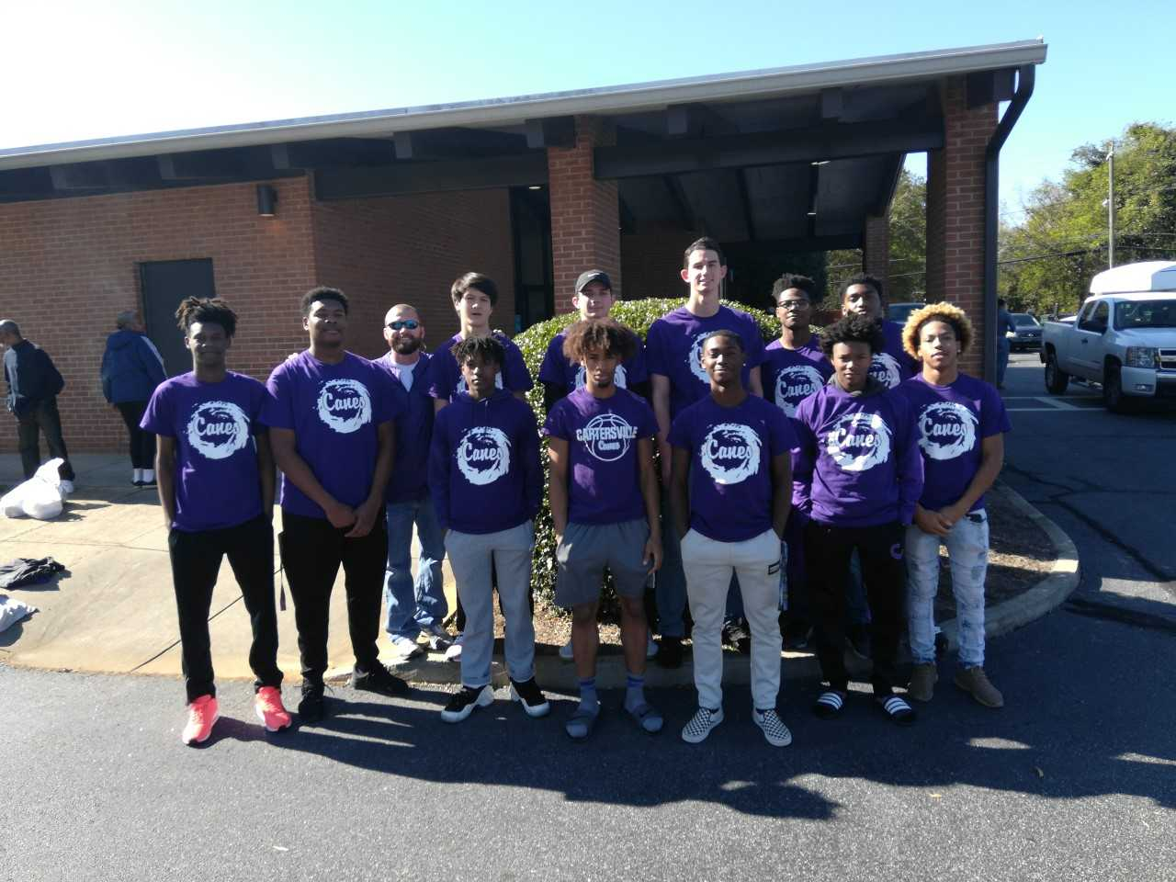
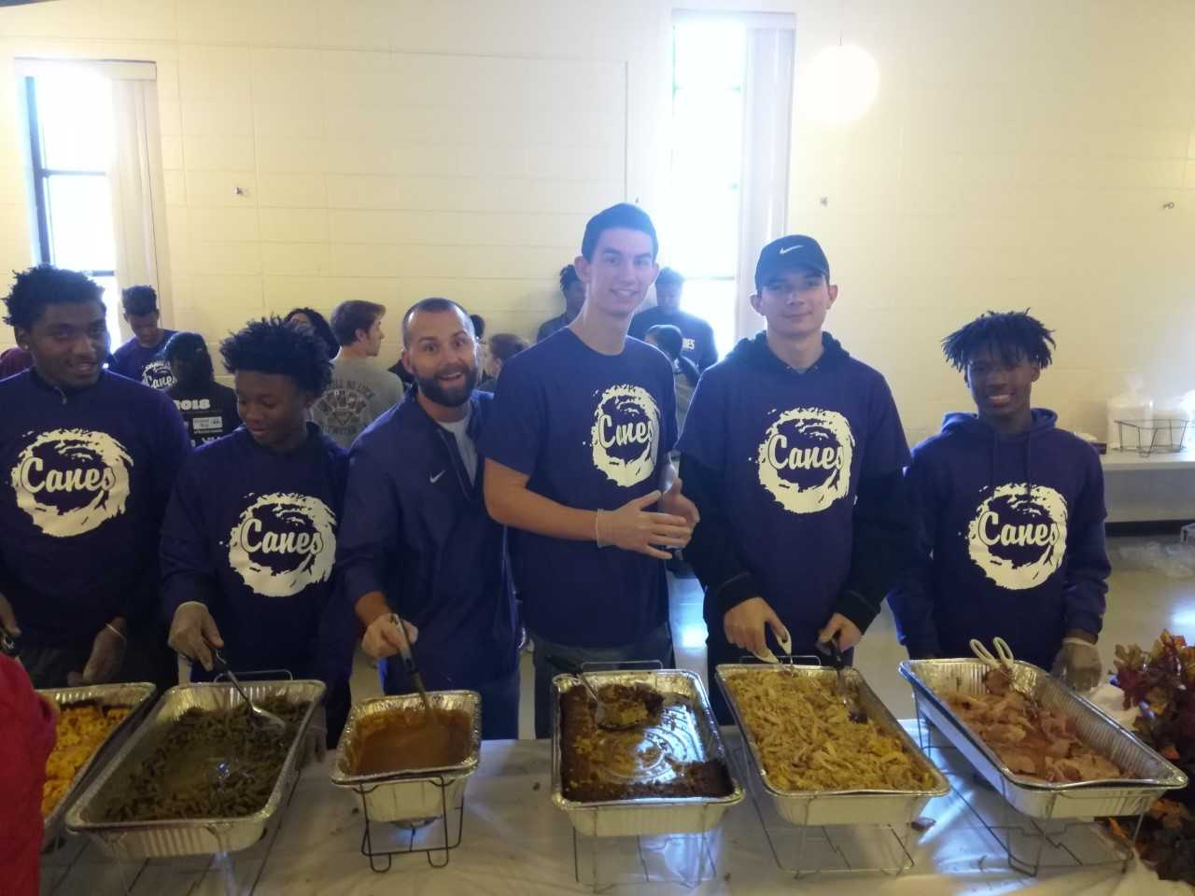
Community Service
Bartow County Feed the Community Event

Slide 6
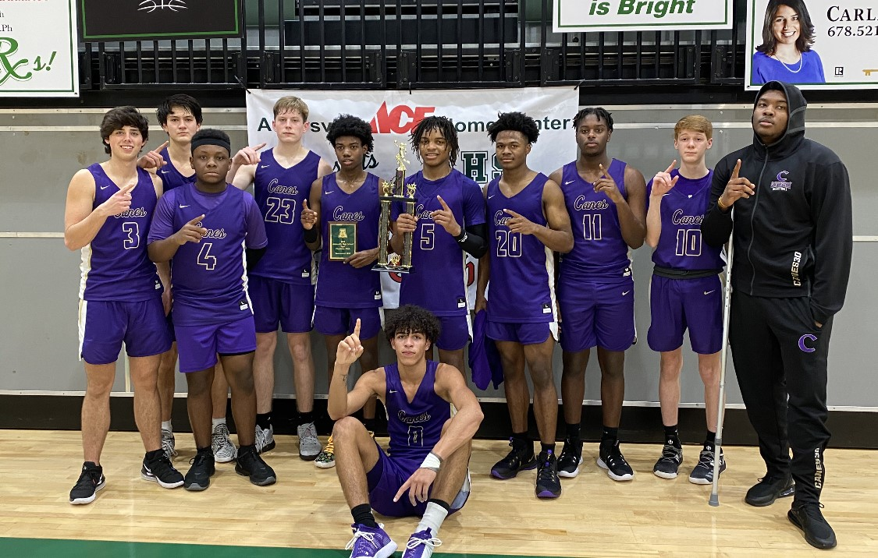
2020
Ace Home Value Tiger Clash Champions

Slide 7
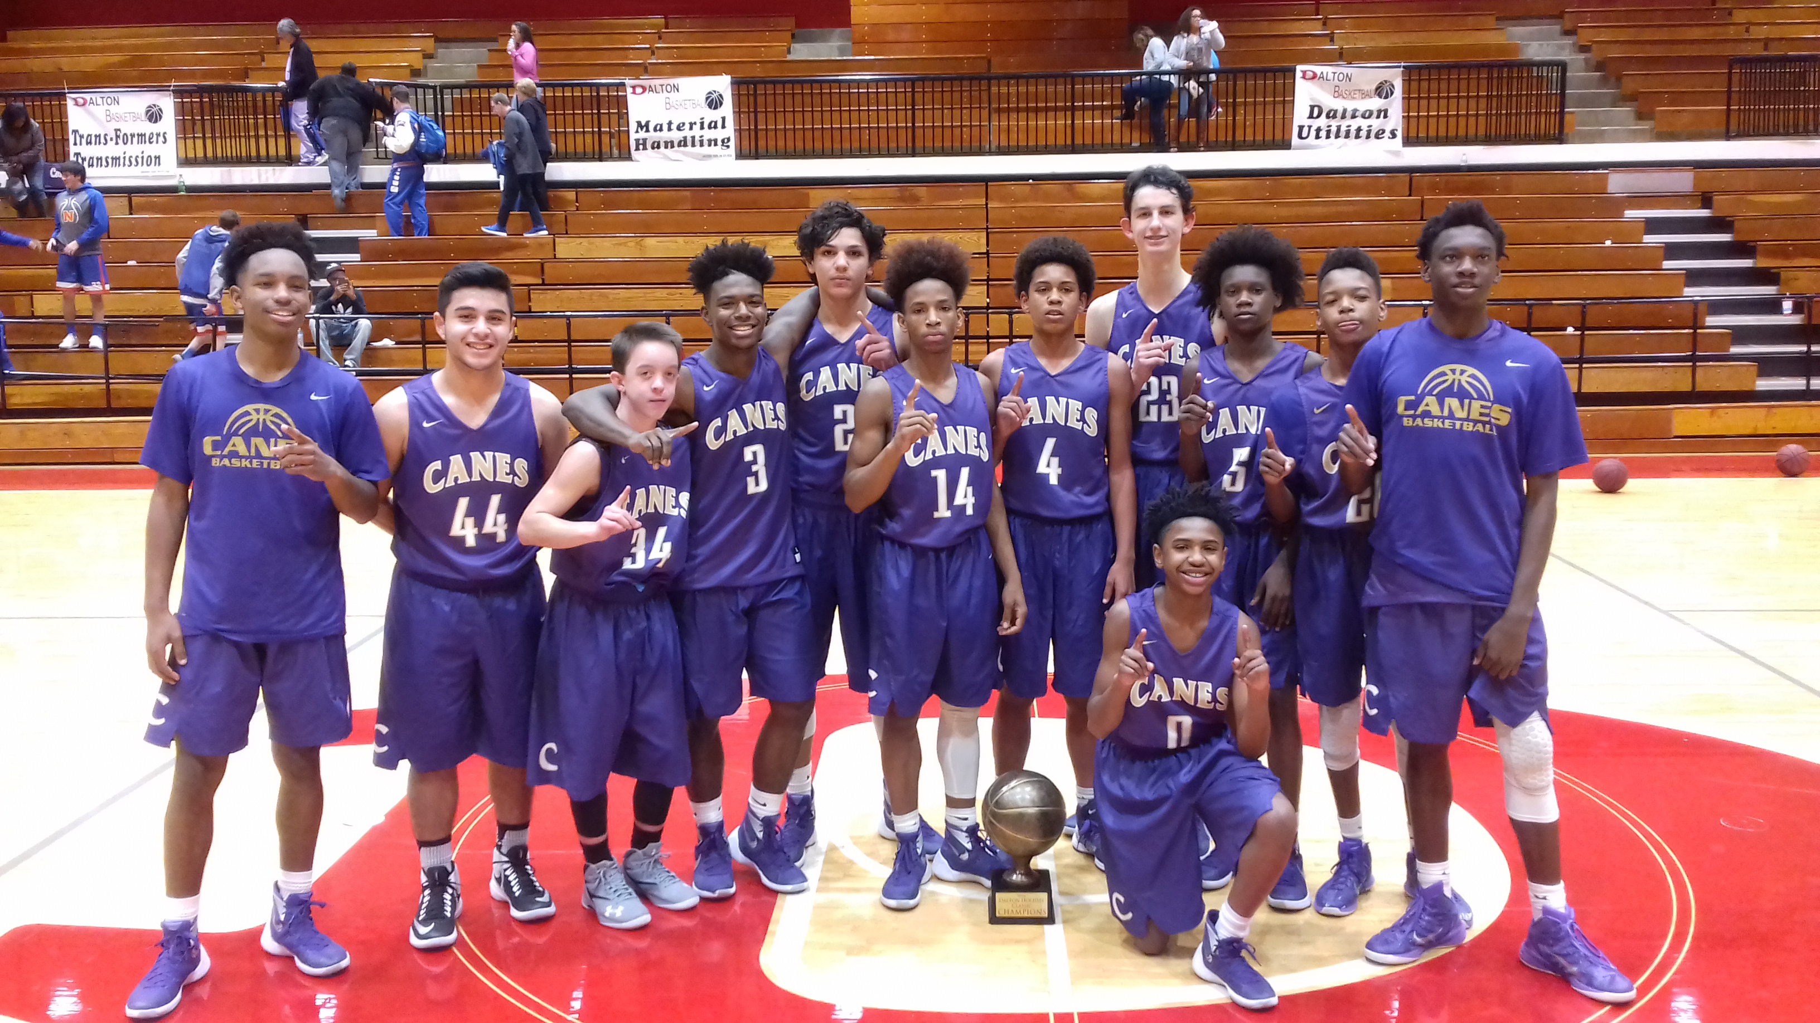
2016 Dalton Holiday Classic Champs

Slide 8
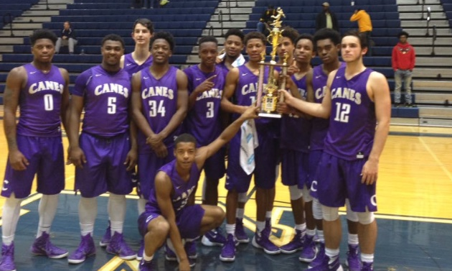
2015
North Paulding Tournament Champions

Slide 9
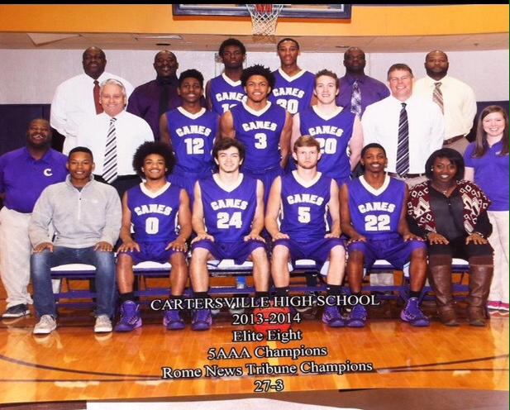

Slide 10
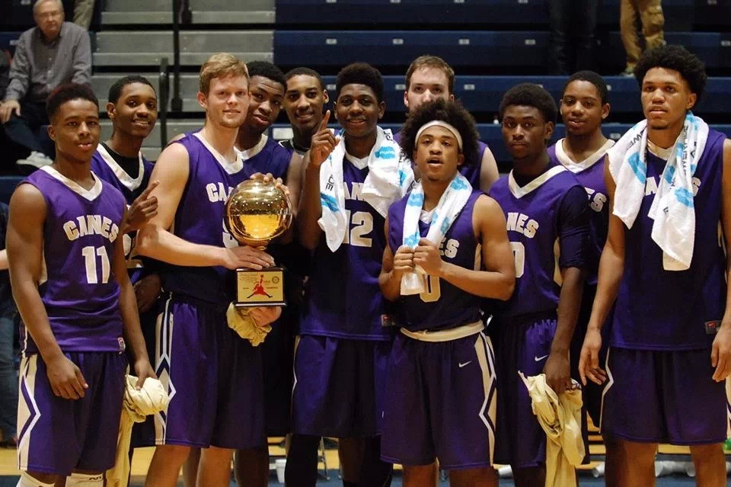
2013 Rome News Tribune Tourney Champs

Slide 11
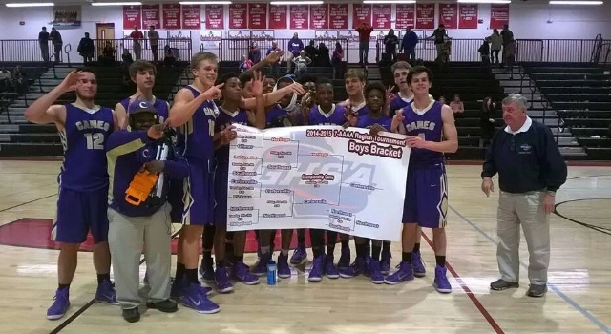
Region Champs 2015

Slide 12
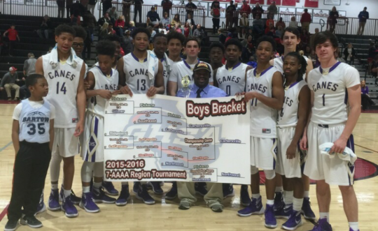
REGION CHAMPS 2016

Slide 13
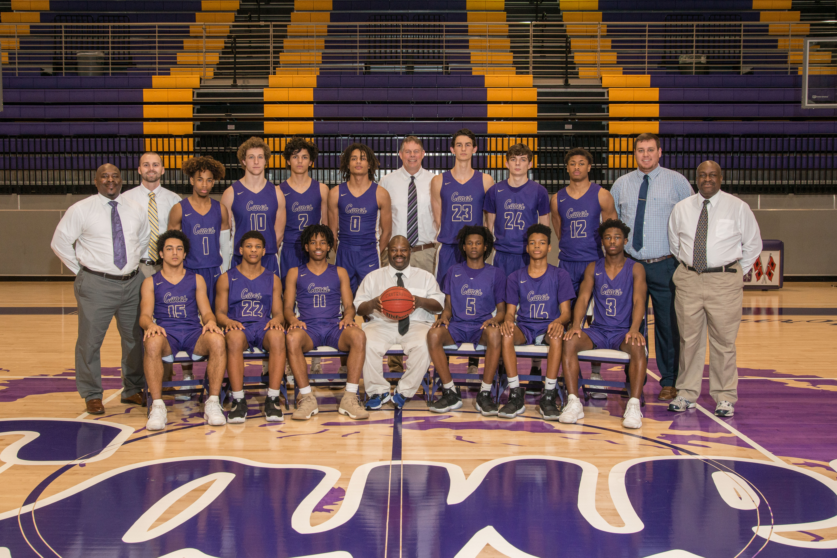
2017-2018
Rome News Tribune Holiday Festival Champions
Region 5AAAA Regular Season Champions
Elite 8 State Tournament
Undefeated at Home

Slide 14
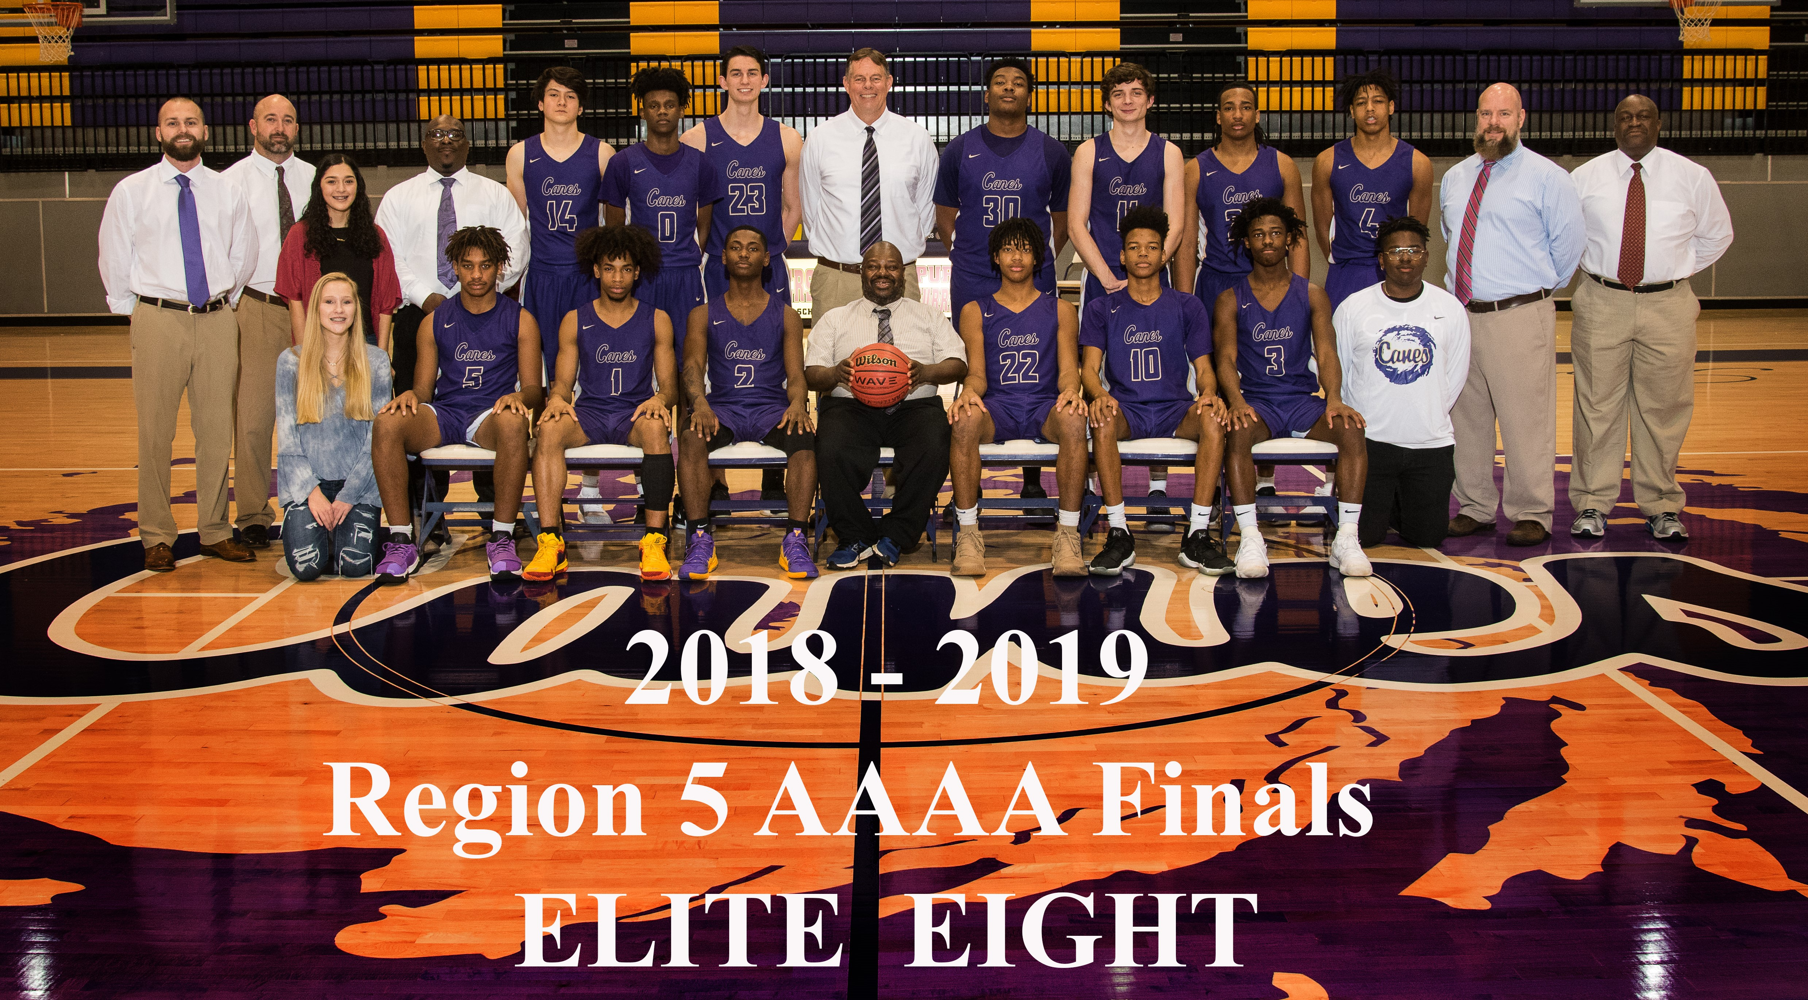

Slide 15
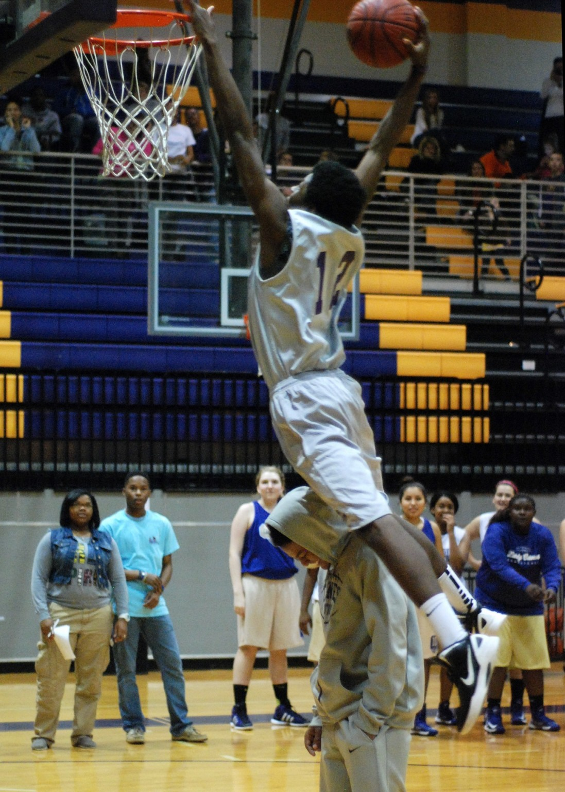
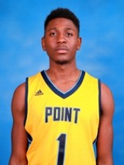
Cane Hoop Players
Playing College Ball
Hakeem Winters - Point University

Slide 16
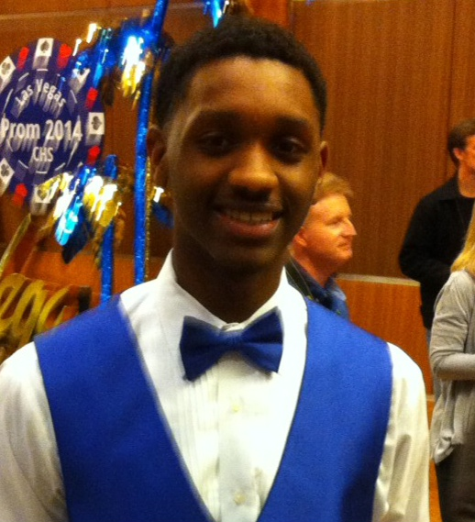
AJ Mosby – Alcorn State University & NBA G League

Slide 17
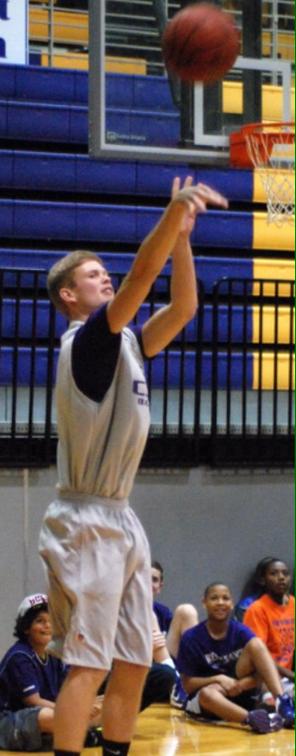
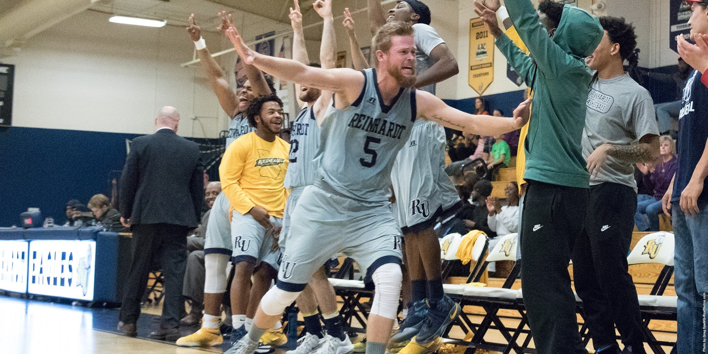
Corey Tobin
Reinhardt University

Slide 18
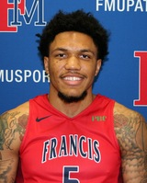
Ryan Davis
Francis Marion University

Slide 19
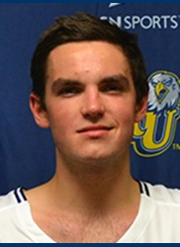
Cade Archer
Reinhardt University

Slide 20
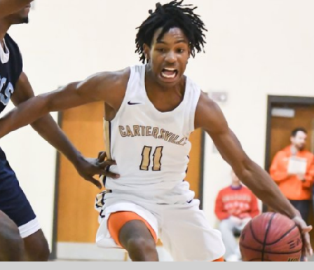
Jaylon Pugh –
Furman University & Lander University

Slide 21
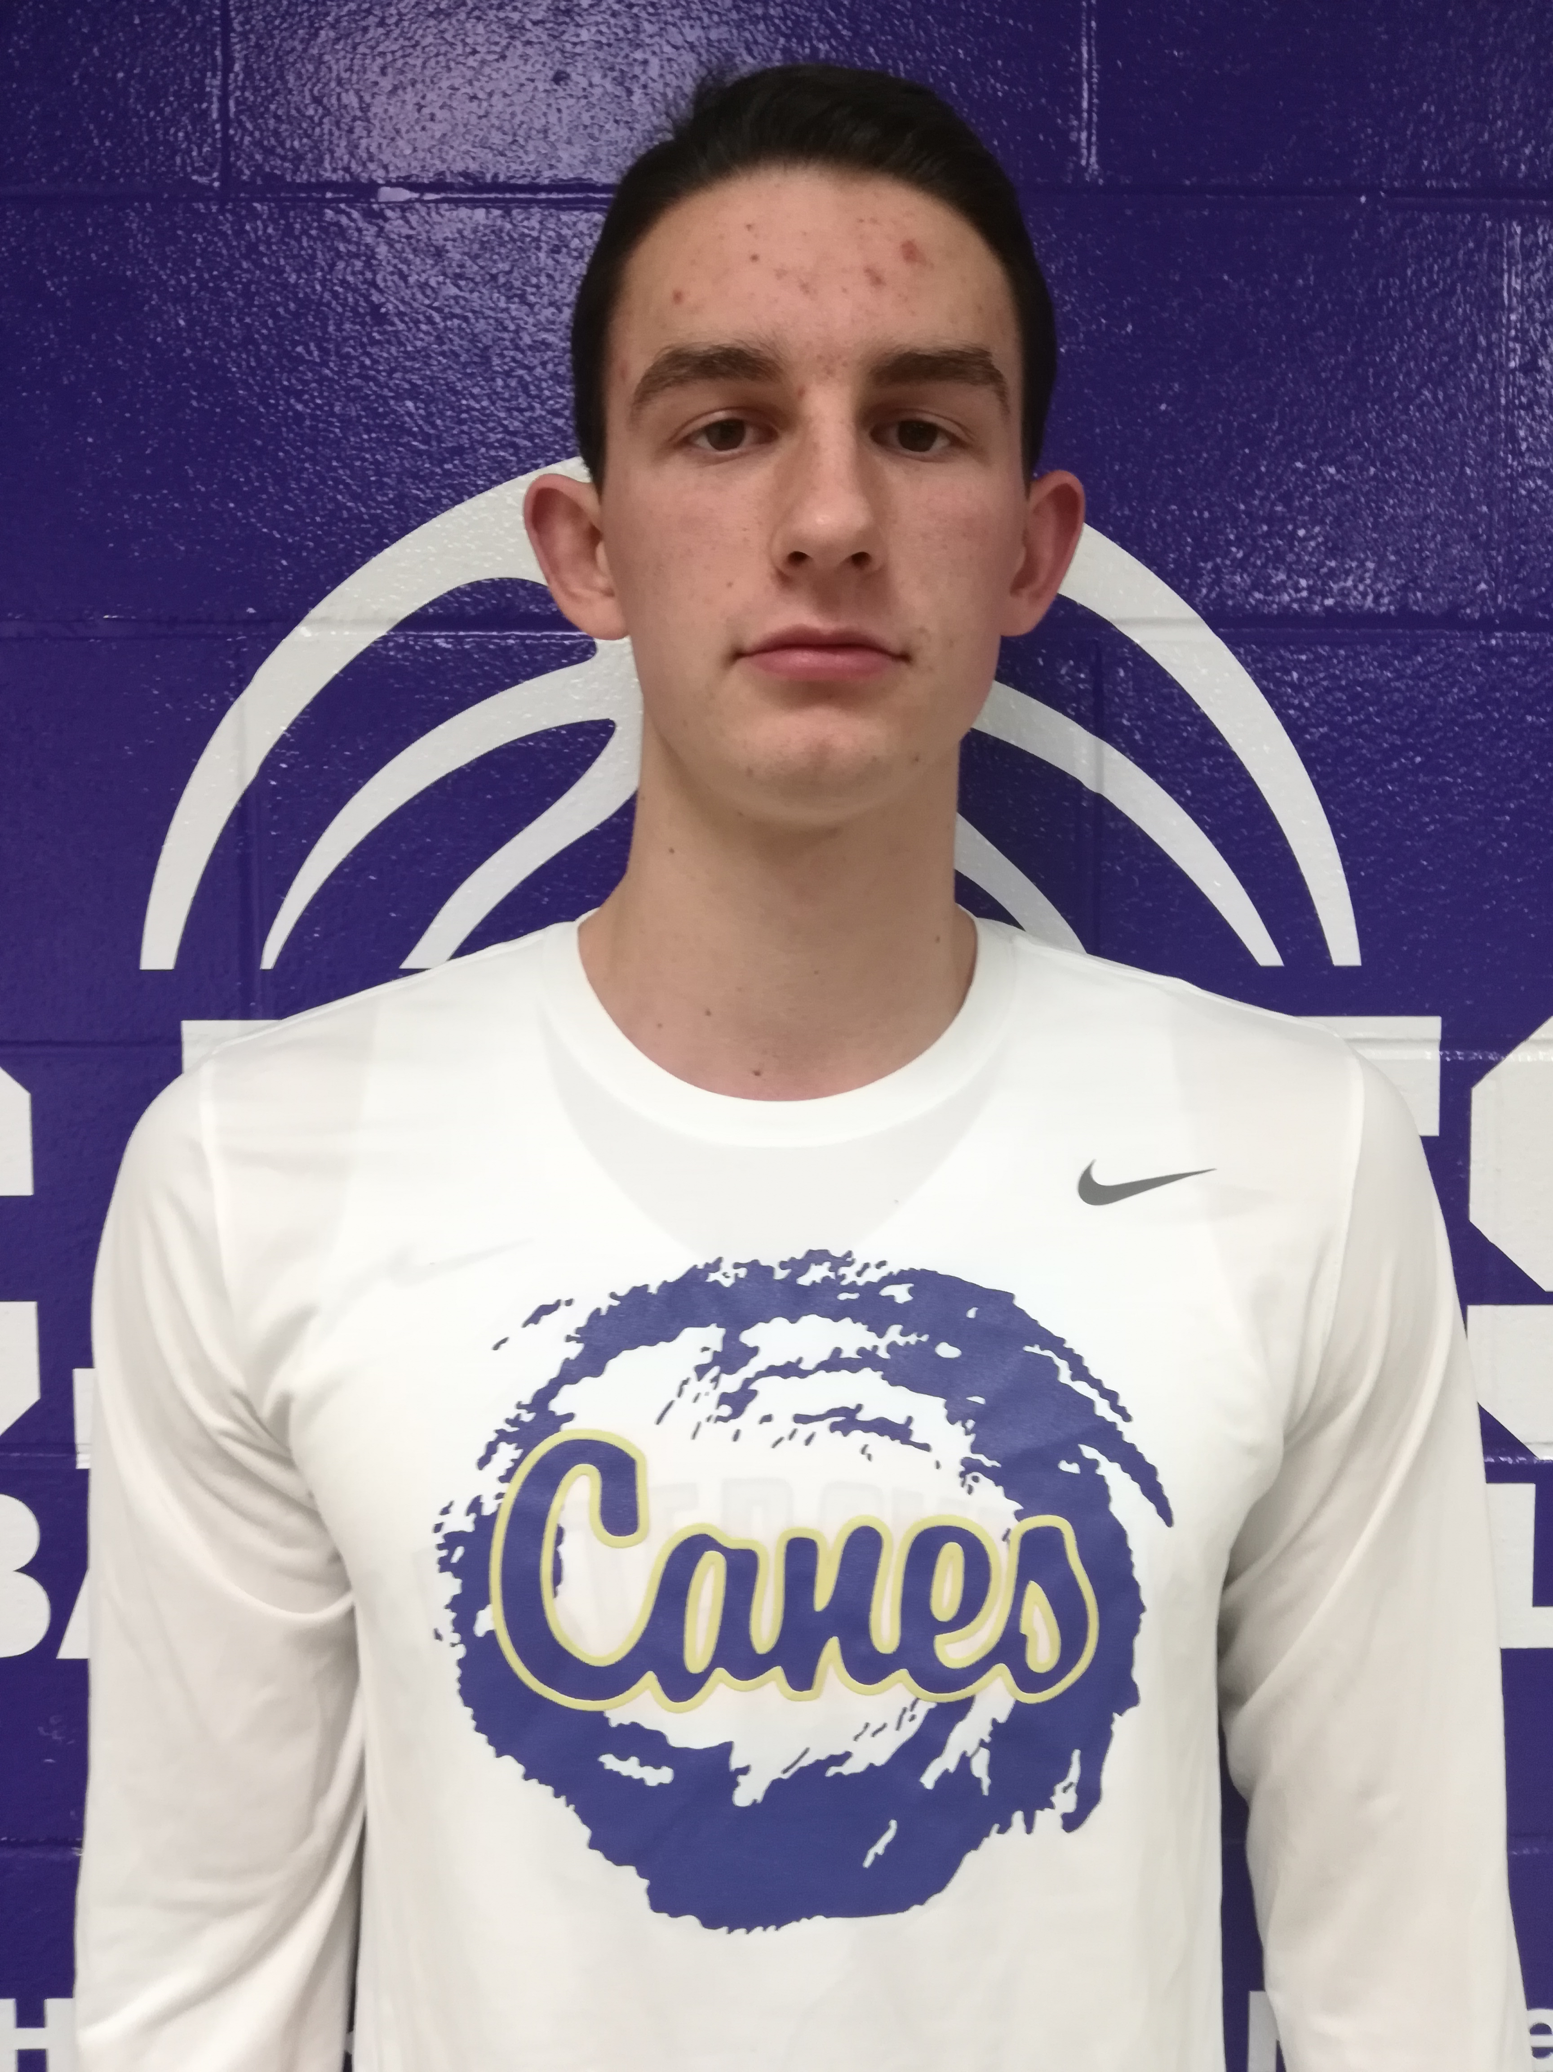
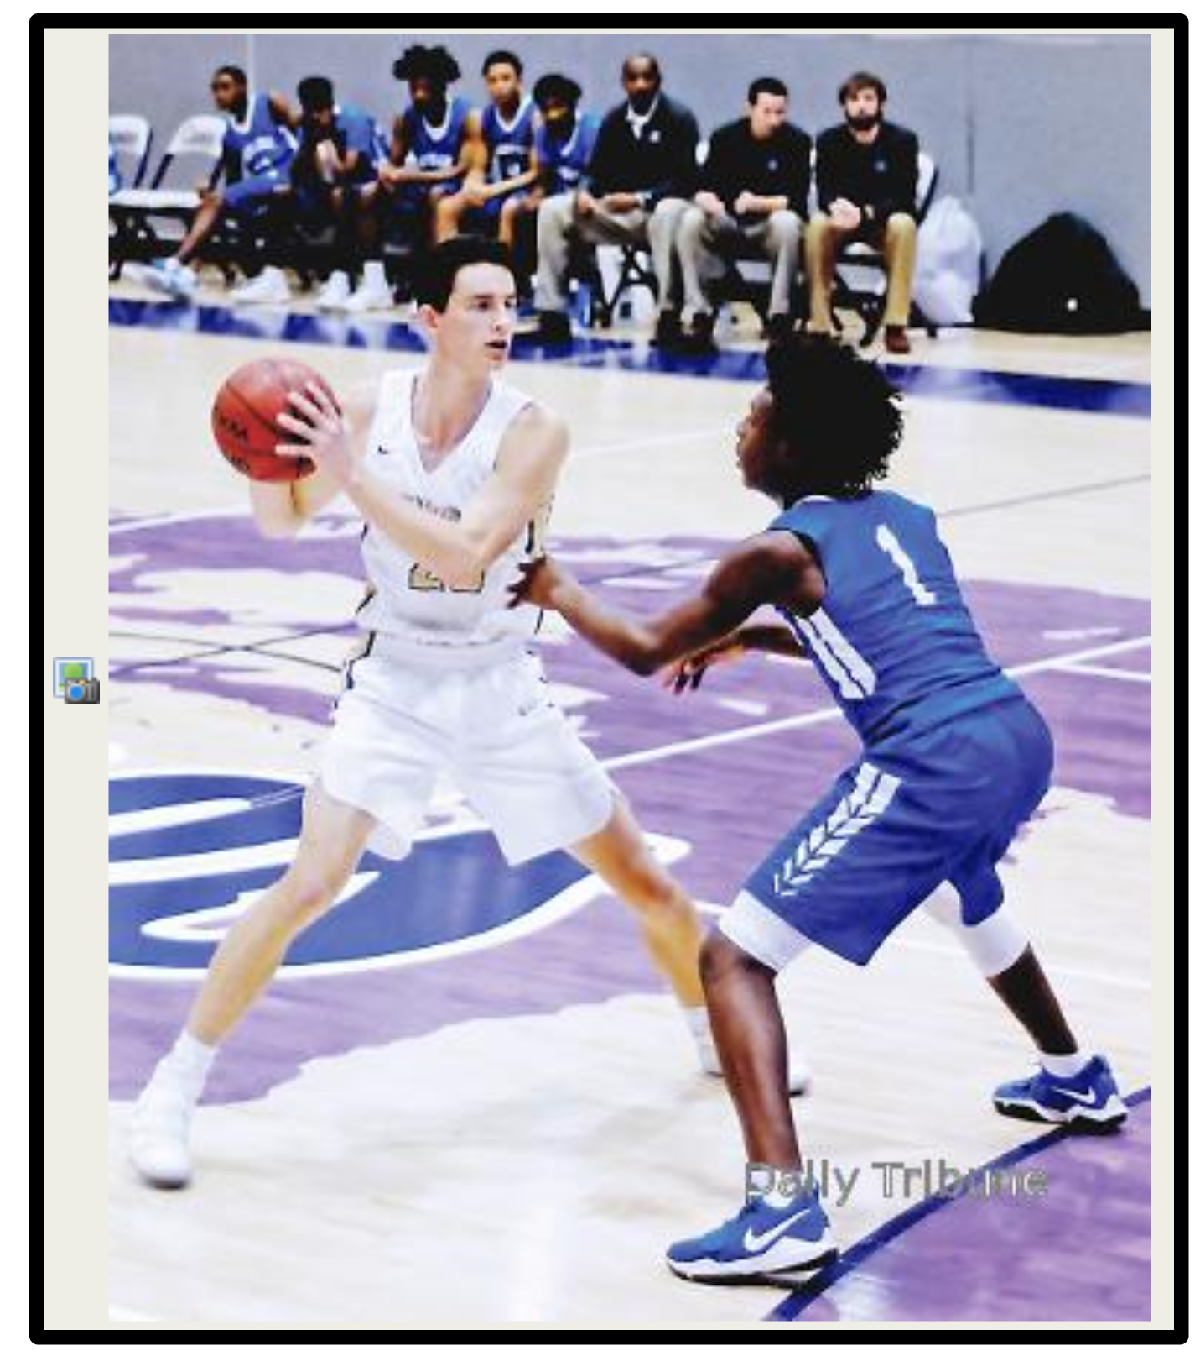
Isaac Gridley
Berry College

Slide 22
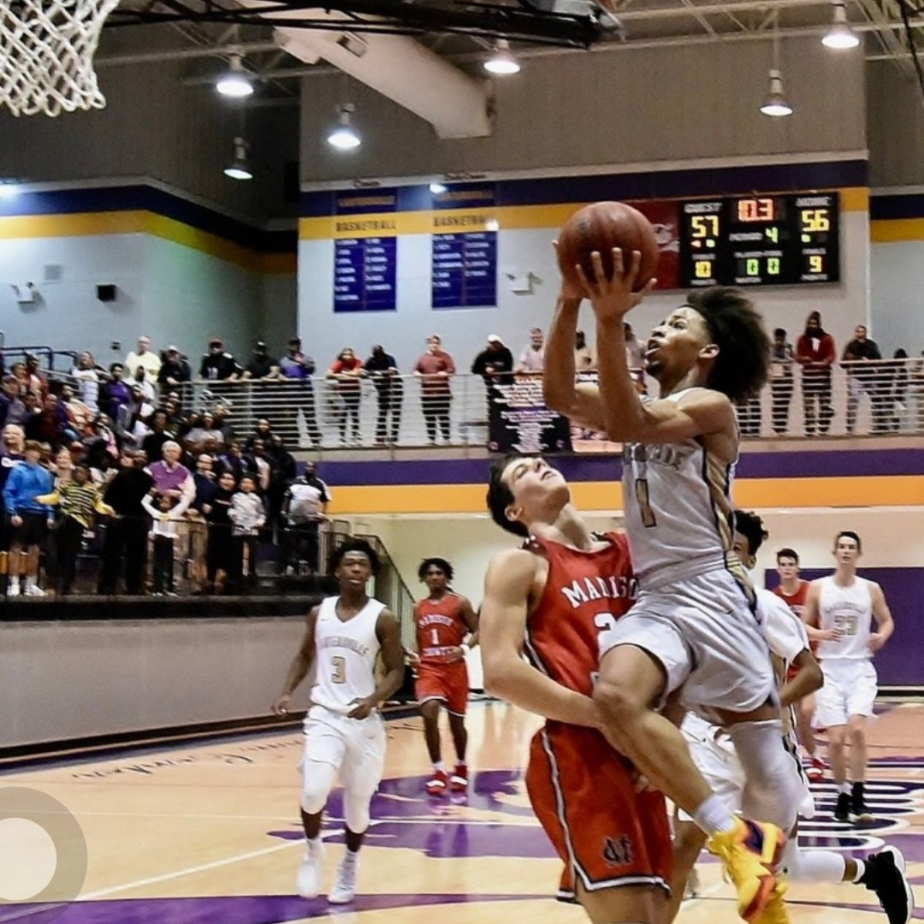
Perignon Dyer
Paine College

Slide 23
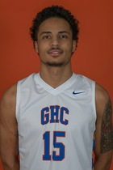
TJ Horton
Georgia Highlands & Dalton State

Slide 24
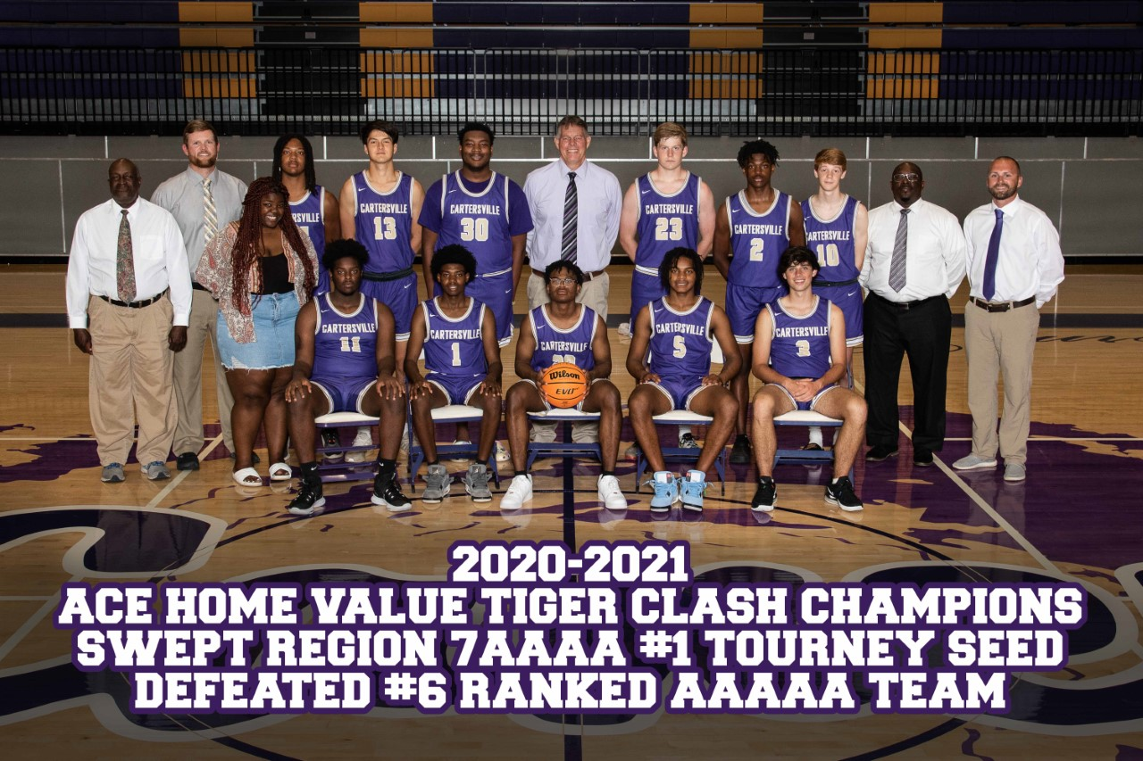

Slide 25
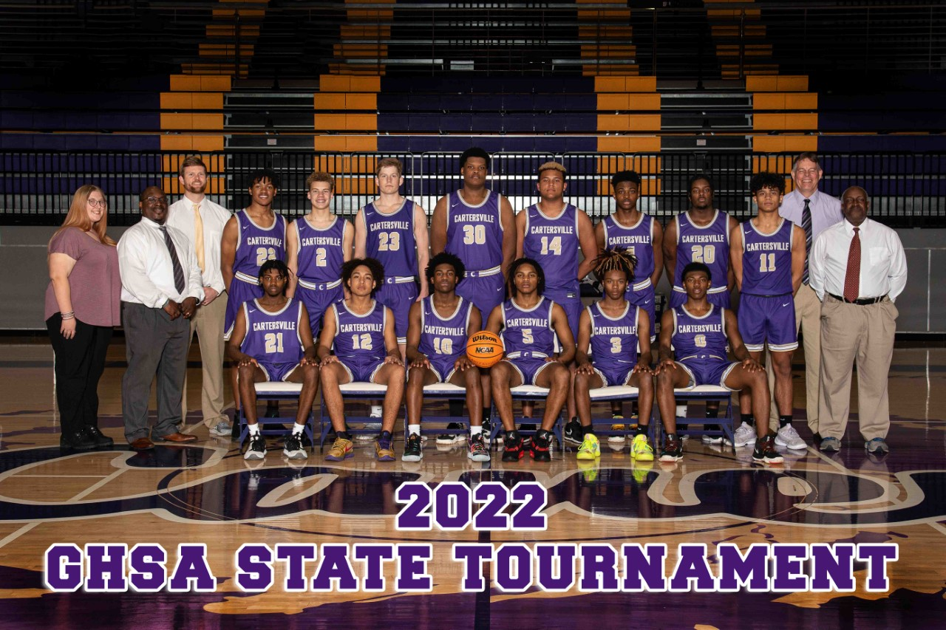

Slide 26
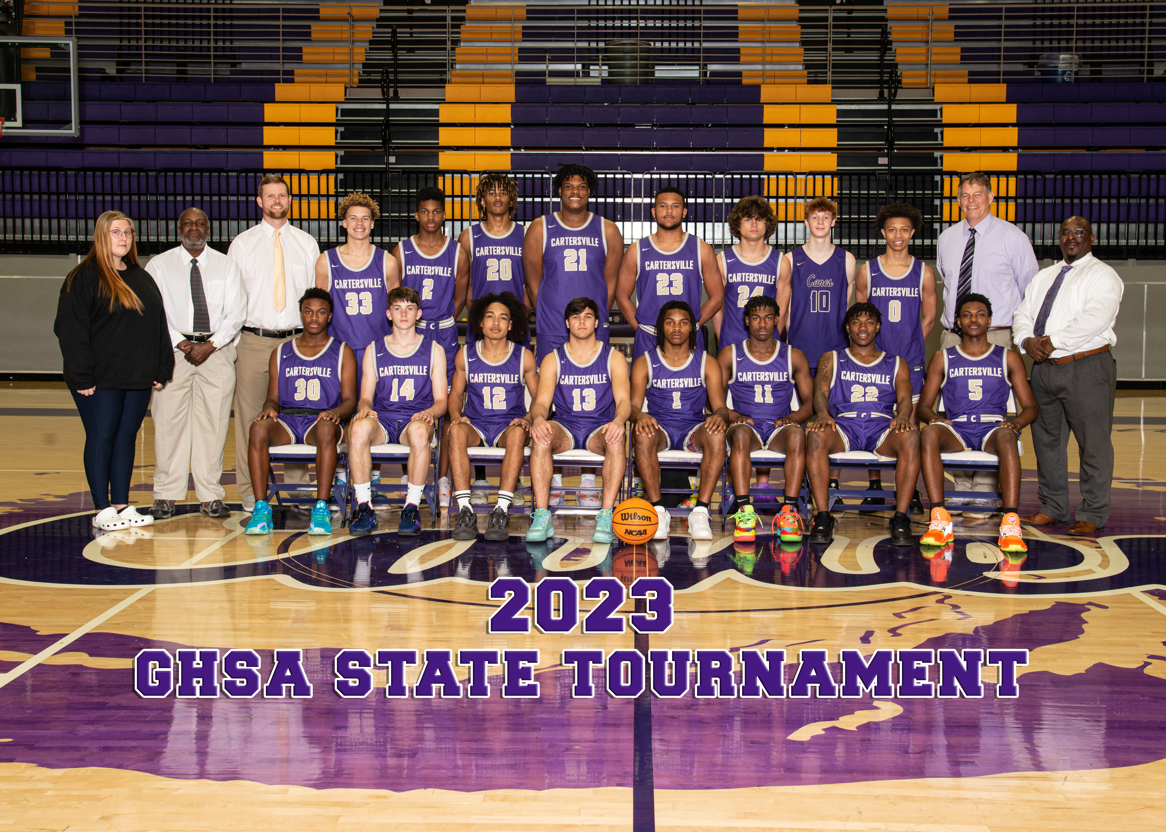

Slide 27
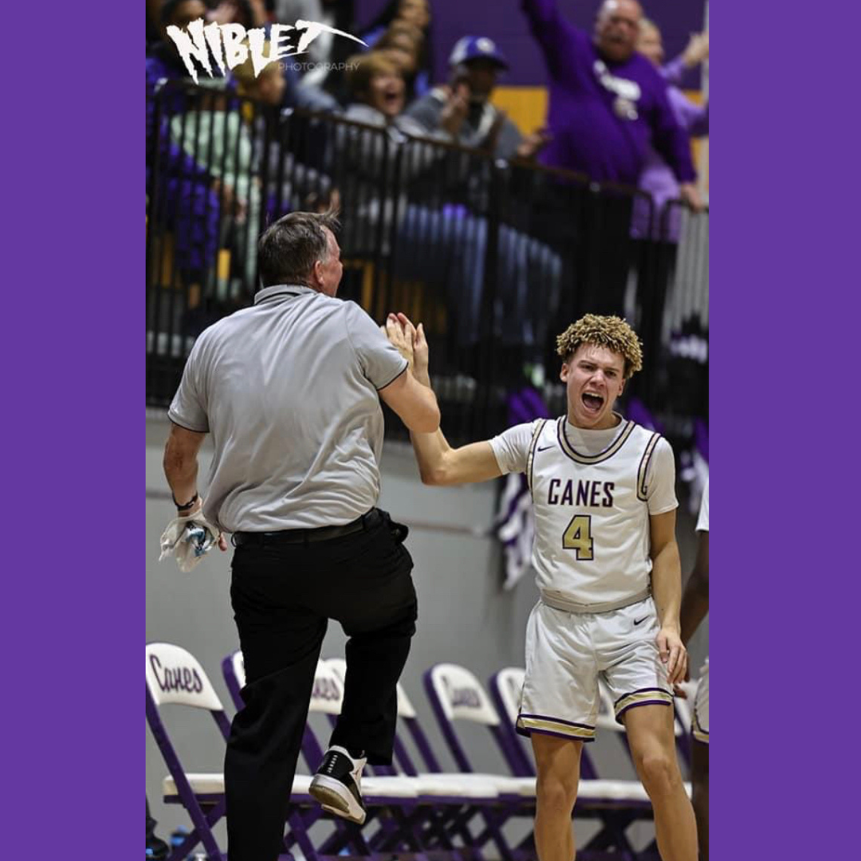
It’s Always a Great Day to be a Purple Hurricane!!

